Slide 1


CSE 270 QA Testing
W. Clements

Slide 2
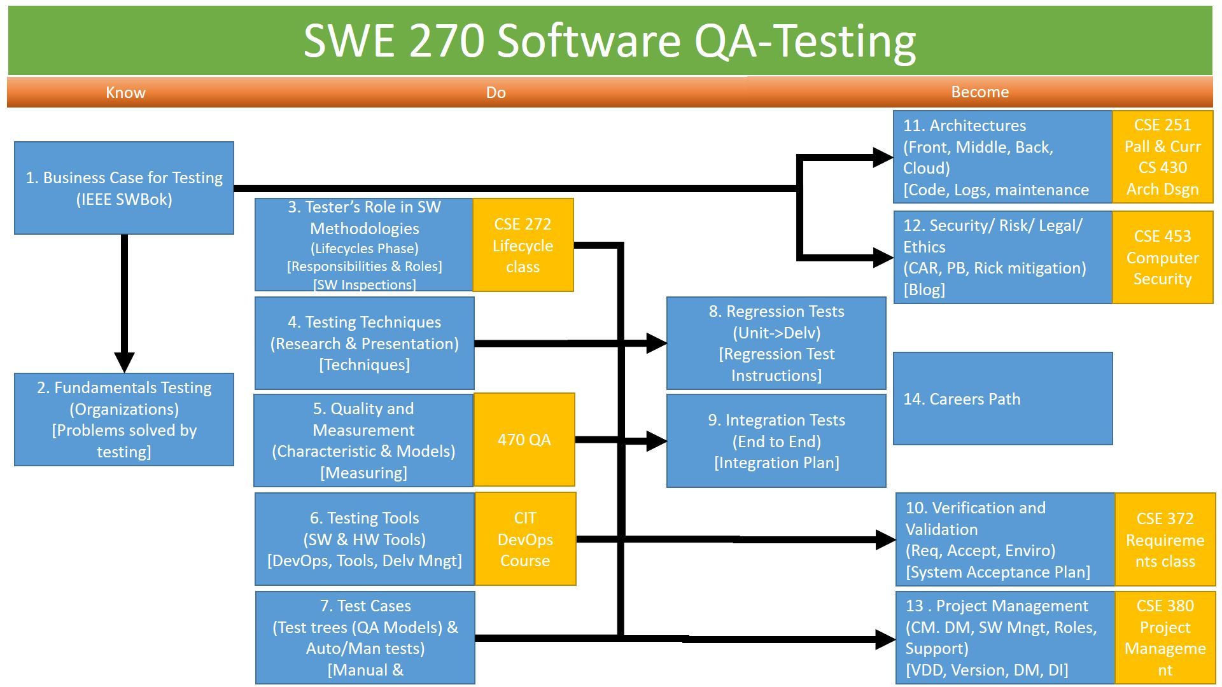
Agenda
Topics
Prepare Quiz
Phone Camera, Article, AST (Association for Software Testing)
Enroll in Groups
Assignment of Organizations for Friday
Class Discussion
Overview of Lab for Wednesday
On Wednesday, bring a digital camera, cell phone, lab top camera, etc
Overview of Prove
Notes:
Discuss and Debate Testing Issues, Business Cases, Management Issues
Discuss Prevention and Management of Testing.
Discuss the purpose of Associations, Organizations, Magazines, websites, and other resources
Introduction of Case Studies
Research Organization:
Enroll in groups
Lab

Slide 3
W02 Prepare Quiz
Download Take notes
Complete Prepare assignments
Read over Teach, Lab and Prove assignments

Slide 4
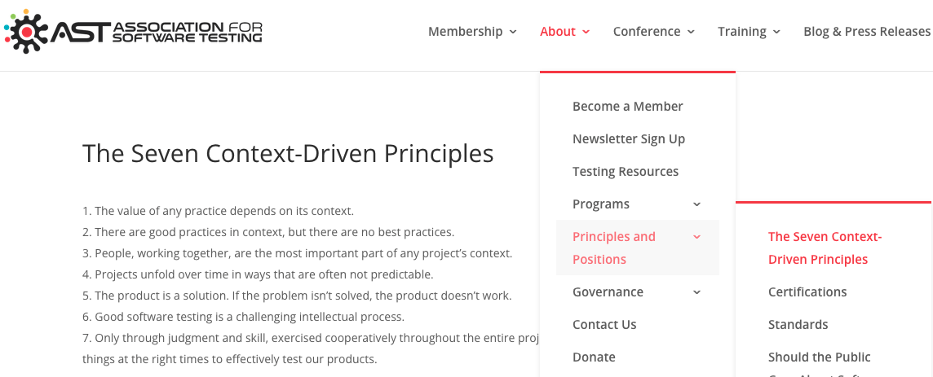
The AST (Association for Software Testing) The Seven Context-Driven Principles
People, working together, are the most important part of any project’s context.
Only through judgment and skill, exercised cooperatively throughout the entire project, are we able to do the right things at the right times to effectively test our products.
The product is a solution. If the problem isn’t solved, the product doesn’t work.
The value of any practice depends on its context.
There are good practices in context, but there are no best practices.
Good software testing is a challenging intellectual process.
Projects unfold over time in ways that are often not predictable.
Test artifacts are worthwhile to the degree that they satisfy their stakeholders’ relevant requirements.
Different types of defects will be revealed by different types of tests.
Metrics that are not valid are dangerous.
Home : About: Principle and Positions
https://www.associationforsoftwaretesting.org/about-the-ast-a-professional-body-for-testers/membership/context-driven-testing/

Slide 5
Teach: What Testing Organizations did you find?
Associations | Acc | Websites
A1QA SW Testing Compnay | A1QA | https://www.a1qa.com/
Agile Alliance |  | https://www.agilealliance.org/
American Society for Quality | ASQ | www.asq.org
American Software Testing Qualifications Board (ASTQB) | ASTQB | https://www.istqb.org
Association for Software Testing | AST | https://www.associationforsoftwaretesting.org/
Association of Testing & Software Quality Assurance | AT*SQA | https://atsqa.org/
BCS The Charted Institute for IT |  | https://www.bcs.org
deviQA |  | https://www.deviqa.com
DZONE |  | https://dzone.com
International Institute for Software Testing | IIST | https://testinginstitute.com/
International Software Testing Qualifications Board | ISTQB | https://www.istqb.org/
ISO |  | https://www.iso.org
Micro Focus |  | https://www.microfocus.com
Official U.S. List of Certified Software Testers |  | https://astqb.org
OWASP™ Foundation |  | https://www.owasp.org
QA InfoTech |  | https://qainfotech.com/
QA Mentor |  | https://www.qamentor.com/
Qualcomm |  | https://www.qualcomm.com/
QualiTest |  | https://www.qualitestgroup.com
QualityLogic |  | https://www.qualitylogic.com/
Stickyminds |  | https://www.stickyminds.com/
TestMatic |  | https://testmatick.com/
Testpoint |  | https://testpoint.com.au/
Tricentis |  | https://www.tricentis.com
CIGNITI |  | https://www.cigniti.com/
You are going to be assigned a specific Testing Organization to research and provide information about:

Slide 6
Teach: What Testing Organizations did you find? – Friday you are going to present
You are going to find an organization, association, or institute that deals with Testing. You will need to answer the following questions:
About:
What is its mission? Why do they exist?
What services do they provide? What do they publish? Training? Certifications?
What publications do they have? How often? Subject Matter? ? (i.e., A.C.M. – Monthly, Ethic Focused)
What certifications do they offer, and why?
Community:
Who are their partners, i.e., companies, organizations, etc.?
Why should you join? How much? What is free, and what is not?
Summary:
Provide a summary of how this resource helps test a professional, business, or project.
References:
What resources did you find? Where did you find your sources?
How many hours did you spend completing this task?

Slide 7
Class Discussion
What is the difference between an association, an organization and an institute?
How do they differ from a Company (Corporation, LLC, Partnership)?
Why are they important?
What is their mission?

Slide 8
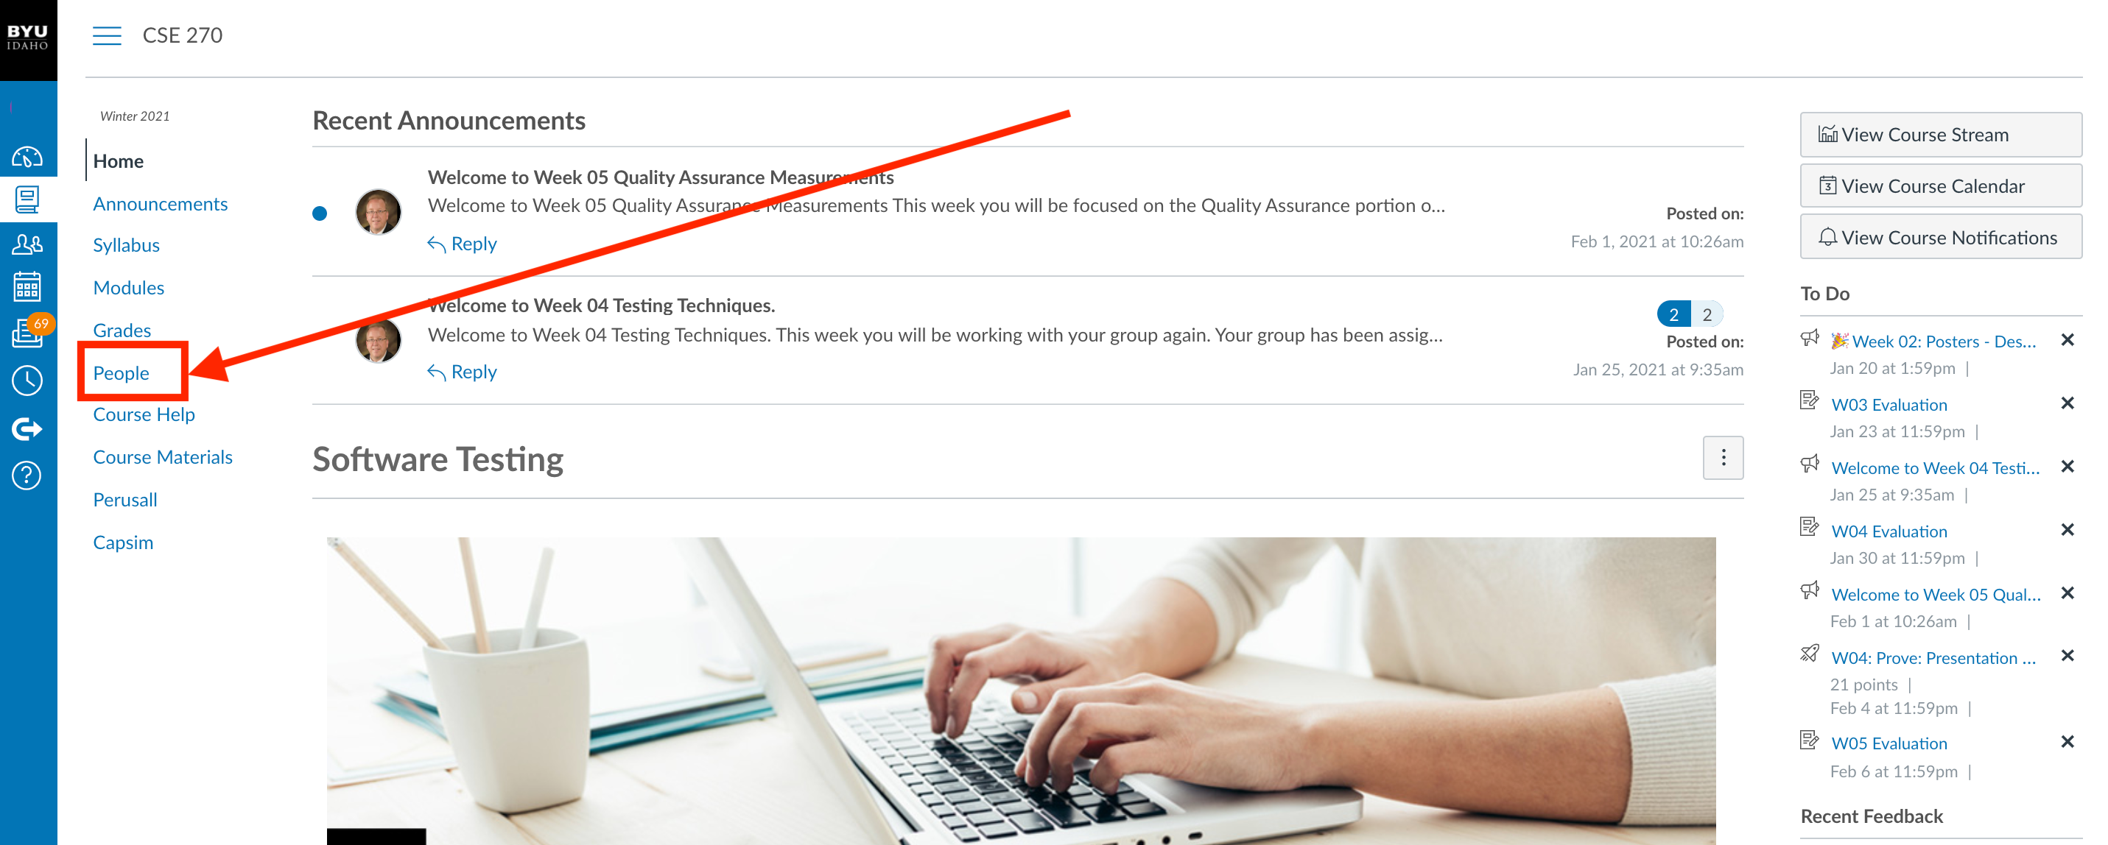
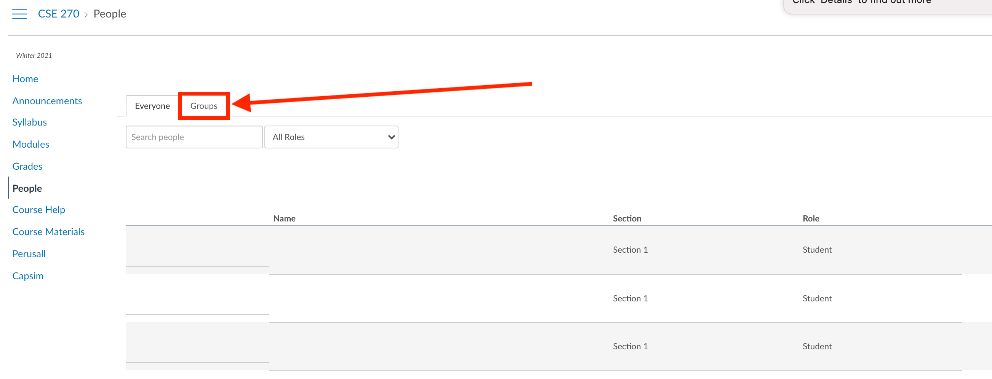
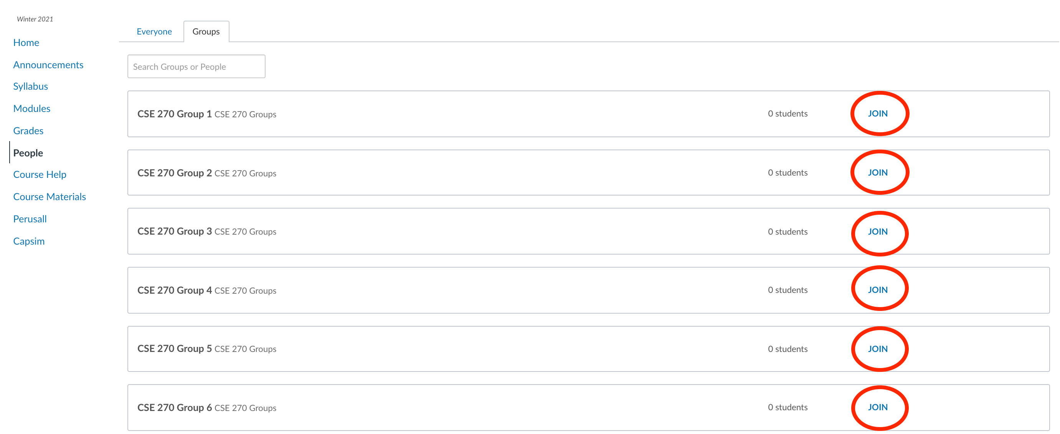
W02: Enroll in a Group

Slide 9
Lab 02 - Camera's Autofocus Algorithm
On Wednesday, bring a digital camera, cell phone, lab top camera, etc
Tasking
Determine how your camera focus
Equation: Determine focus speed
Write a test for someone else
Post summary

Slide 10
CSE 270: W02 Report: Auto-Focus
Understand Your Sources
The purpose of this learning activity is to report on what we have found in our personal research, and to read about what other people have found.
How do cameras focus?
Report on Your Finding
Search for a previous thread
Report on everything you have learned.
Cite your sources.

Slide 11
How to write a test plan and cases?
History of tests
Elements/Pattern of a Test Case
Prefix: ID, Description/Summary, Pre-requisites, category/component, author/POC, Requirement
Test Steps: Some (A)ction followed by (R)esults, until you (V)erify the requirement.
A test verifies feature: a concept (acceptance), requirements(system), architecture/workflow (integration), design/element (regression) or component (unit testing)
Test Steps
Action: Specifically identify what needs to happen in logical sequence.
If there is a branch, then it is a sperate test
Results/Verify: What was the results of the action.
New window, some state change, etc
Last step before cleanup is verifying that the actions verified a feature
Pass/Fail - Some indication that it passed or failed

Slide 12
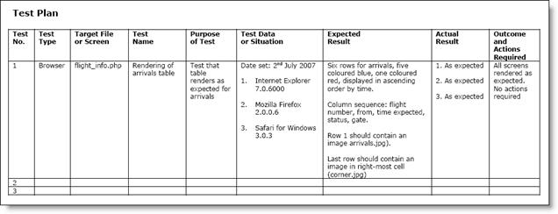
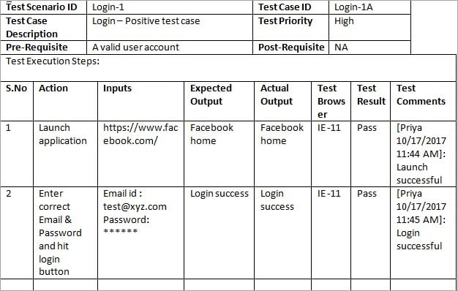
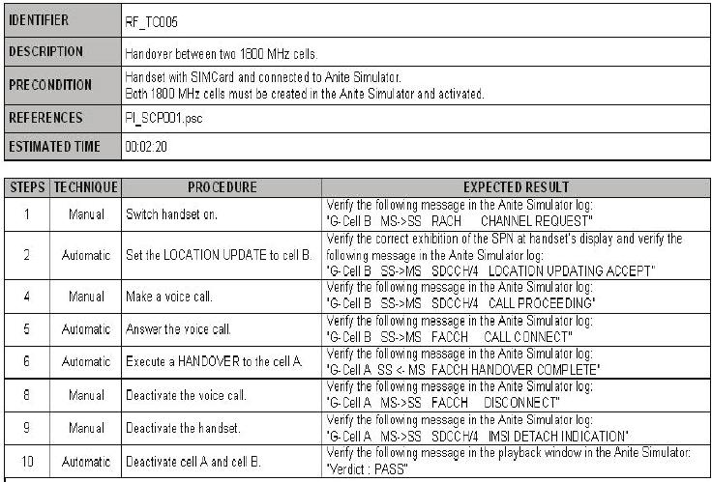
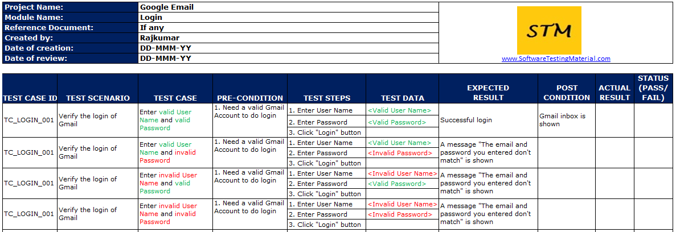

Slide 13

The Eye Camera

Slide 14
Lab 02 - Camera's Autofocus Algorithm
On Wednesday, bring a digital camera, cell phone, lab top camera, etc
Tasking
6+ Tests
Post summary

Slide 15
Day 2: Agenda
Watch Video: PBJ sandwich
Ideas for tests.
Types of tests:
Finish research as start writing tests
Swap tests with another group.
Day 3: Friday
Assignments for next week topics

Slide 16
Experiment:
Use a red filter or red light vs. a blue light to test focus.
Determine the type of focus?:
Determine if your camera is using a phase by putting a cover on the lens.
Determine if your camera is using a laser. Check I.R. with another camera.
Experiment with Distance? Too close, Too Far, Optimal
How does light affect autofocus? Too dark, Too Light, Optimal
How does color affect autofocus?
Where the object is in view: Sides(Vertical vs Horizontal) vs Center
How does movement affect the focus?
How quickly can it adjust to two different distances?
For cell phone, how does the front vs back camera differ?
How does different textures affect the focus? Carpet vs Ceiling vs Wall or other
Place a filter in front of the camera (sheet protector simulating smooges on the lens)

Slide 17
Lab 02 - Camera's Autofocus Algorithm
Observations:
Phase-Detection Autofocus
According to Samsung, the Galaxy S5 can focus in an image in only 0.3 seconds using phase-detection auto-focus.
Laser Autofocus: Active Autofocus
It’s super-fast. According to LG, it only takes 0.276 seconds to focus an image with laser auto-focus.

Slide 18


Slide 19


Slide 20


Slide 21
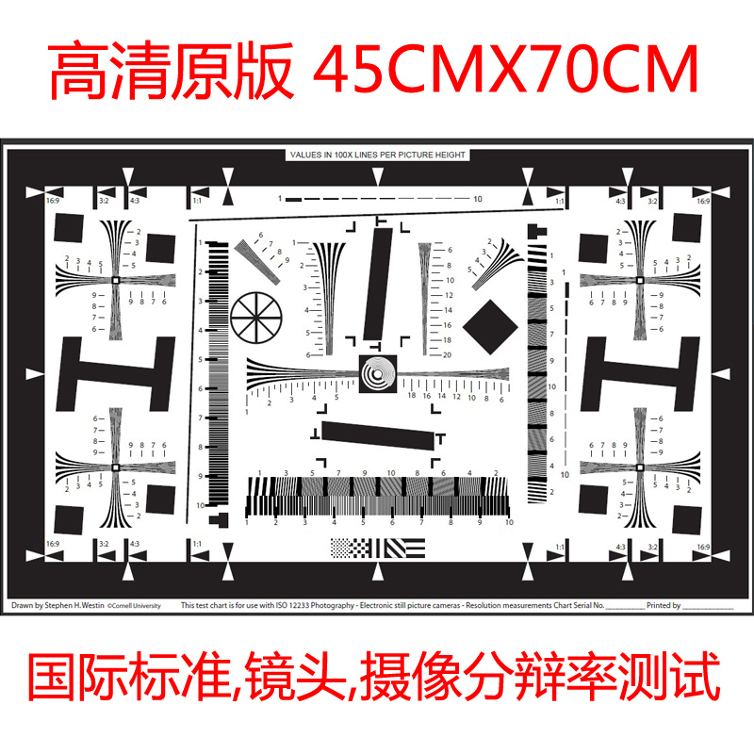

Slide 22
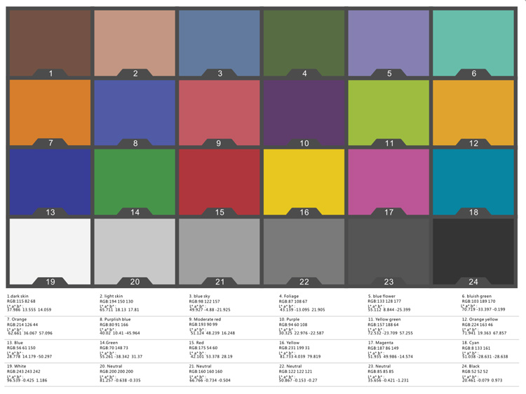

Slide 23


Slide 24


Slide 25
With My Camera Phone

Slide 26


Slide 27
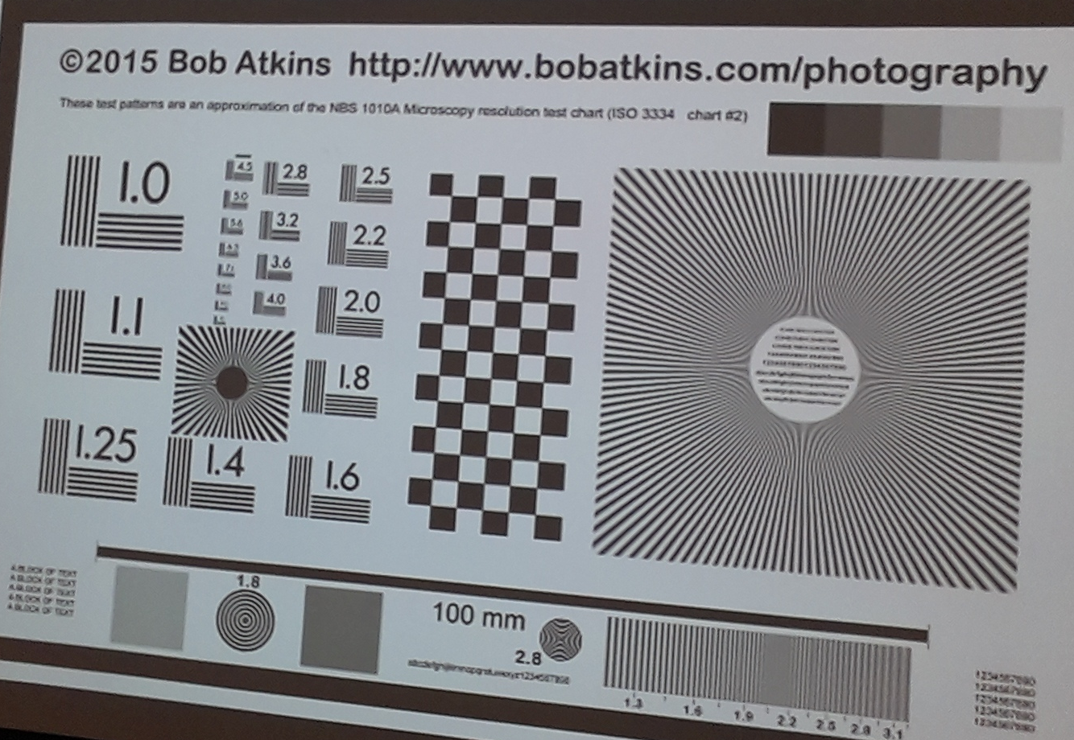

Slide 28



Slide 29

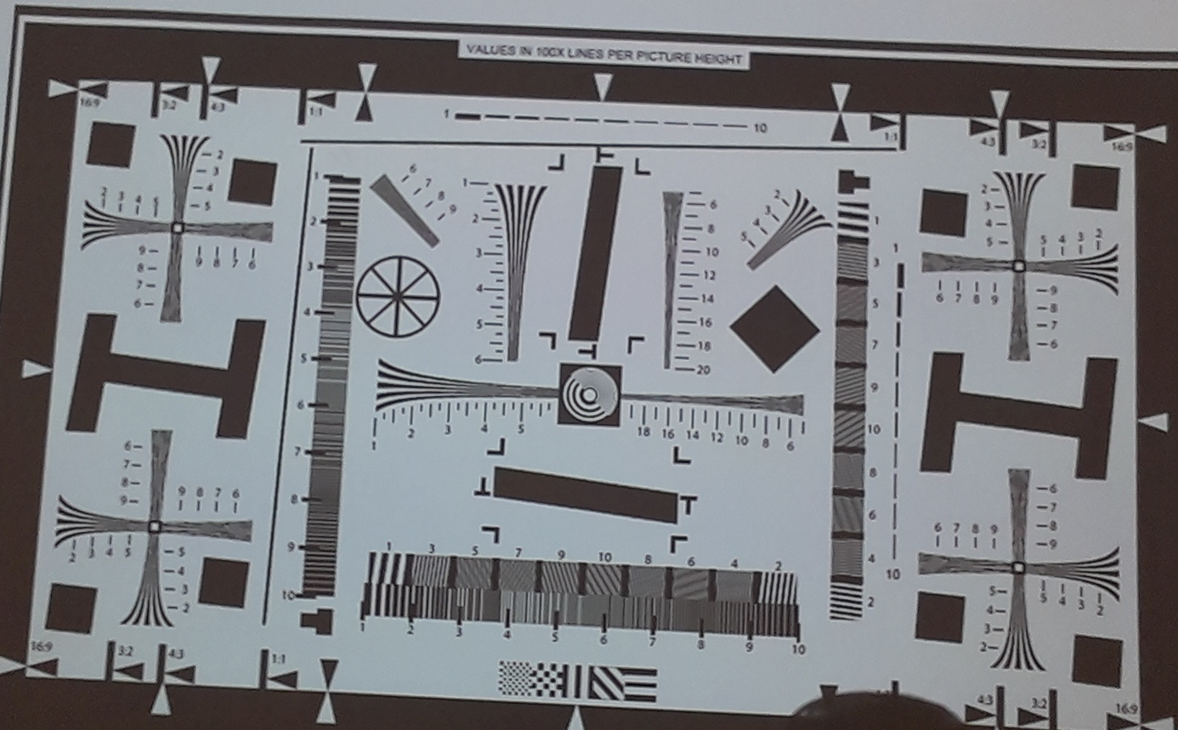

Slide 30



Slide 31
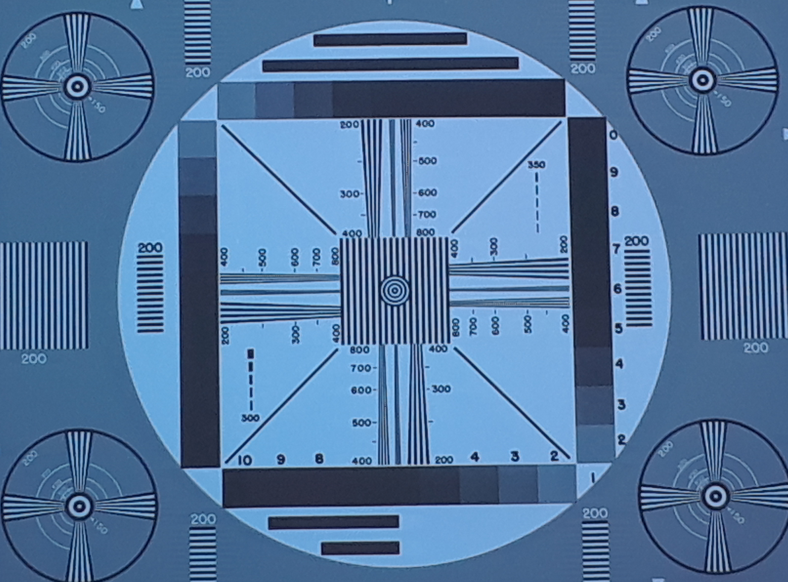
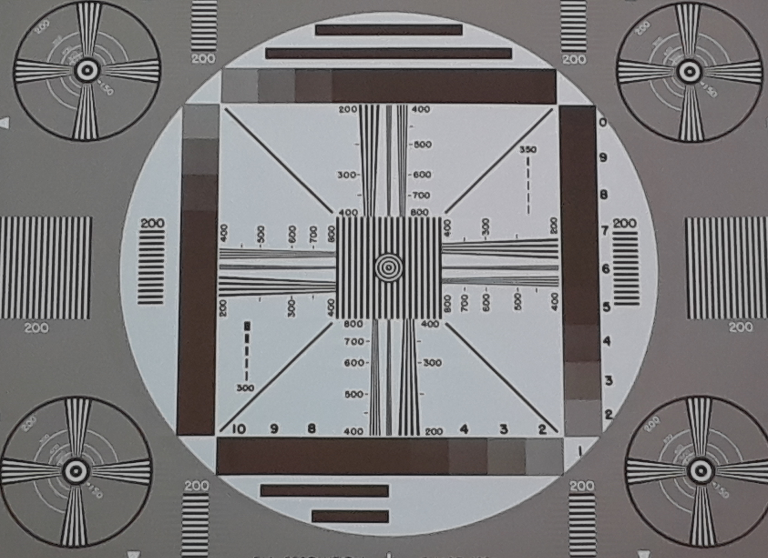
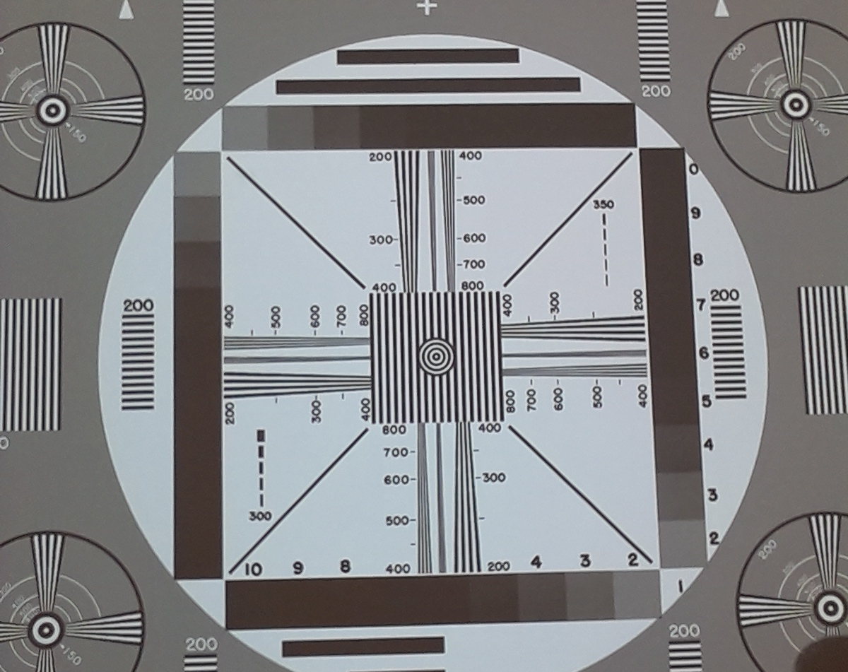

Slide 32
Equation:
Observations:
Phase-Detection Autofocus
According to Samsung, the Galaxy S5 can focus in an image in only 0.3 seconds using phase-detection auto-focus.
Laser Autofocus: Active Autofocus
It’s super-fast. According to LG, it only takes 0.276 seconds to focus an image with laser auto-focus.
Using the equation found in the article,
Distance traveled by laser beam = Speed of Light * Time to receive reflection
Distance to object = Distance traveled by laser beam / 2

Slide 33
Test:
Write up a test based on your findings that you could give to someone else, possibly a family member, a neighbor, or a friend. Do this so that if they followed your test, they could come up with the same results. Make sure you address these questions in your test:
How will the test be set up?
What is the previous knowledge needed?
What steps did you take to discover your results?
What were the expected results?
Were you able to break the camera's autofocus algorithm?

Slide 34
Follow up:
Post a summary of your observation, experiment, equations, and tests, then answer the following questions:
Which of the options would be best?
Did your first attempt work successfully? Why or Why not? What did you learn for the non-success or success?

Slide 35
Friday

Slide 36
Associations | Acc | Websites
A1QA SW Testing Compnay | A1QA | https://www.a1qa.com/
Agile Alliance |  | https://www.agilealliance.org/
American Society for Quality | ASQ | www.asq.org
American Software Testing Qualifications Board (ASTQB) | ASTQB | https://www.istqb.org
Association for Software Testing | AST | https://www.associationforsoftwaretesting.org/
Association of Testing & Software Quality Assurance | AT*SQA | https://atsqa.org/
BCS The Charted Institute for IT |  | https://www.bcs.org
deviQA |  | https://www.deviqa.com
DZONE |  | https://dzone.com
International Institute for Software Testing | IIST | https://testinginstitute.com/
International Software Testing Qualifications Board | ISTQB | https://www.istqb.org/
ISO |  | https://www.iso.org
Micro Focus |  | https://www.microfocus.com
Official U.S. List of Certified Software Testers |  | https://astqb.org
OWASP™ Foundation |  | https://www.owasp.org
QA InfoTech |  | https://qainfotech.com/
QA Mentor |  | https://www.qamentor.com/
Qualcomm |  | https://www.qualcomm.com/
QualiTest |  | https://www.qualitestgroup.com
QualityLogic |  | https://www.qualitylogic.com/
Stickyminds |  | https://www.stickyminds.com/
TestMatic |  | https://testmatick.com/
Testpoint |  | https://testpoint.com.au/
Tricentis |  | https://www.tricentis.com
CIGNITI |  | https://www.cigniti.com/

Slide 37
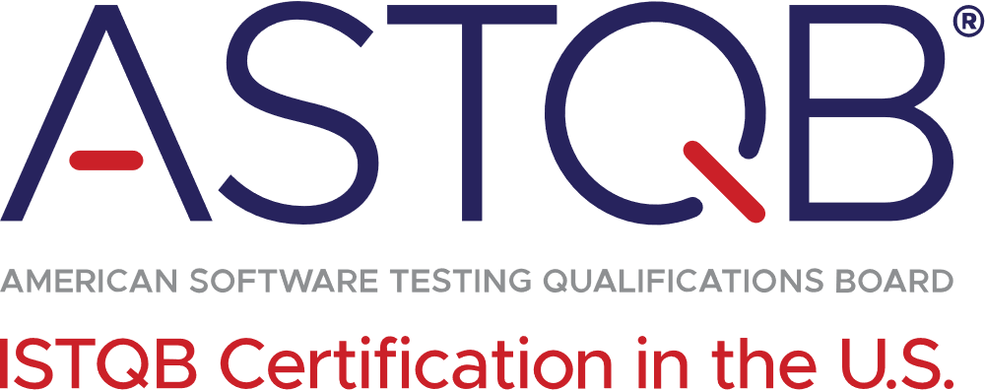
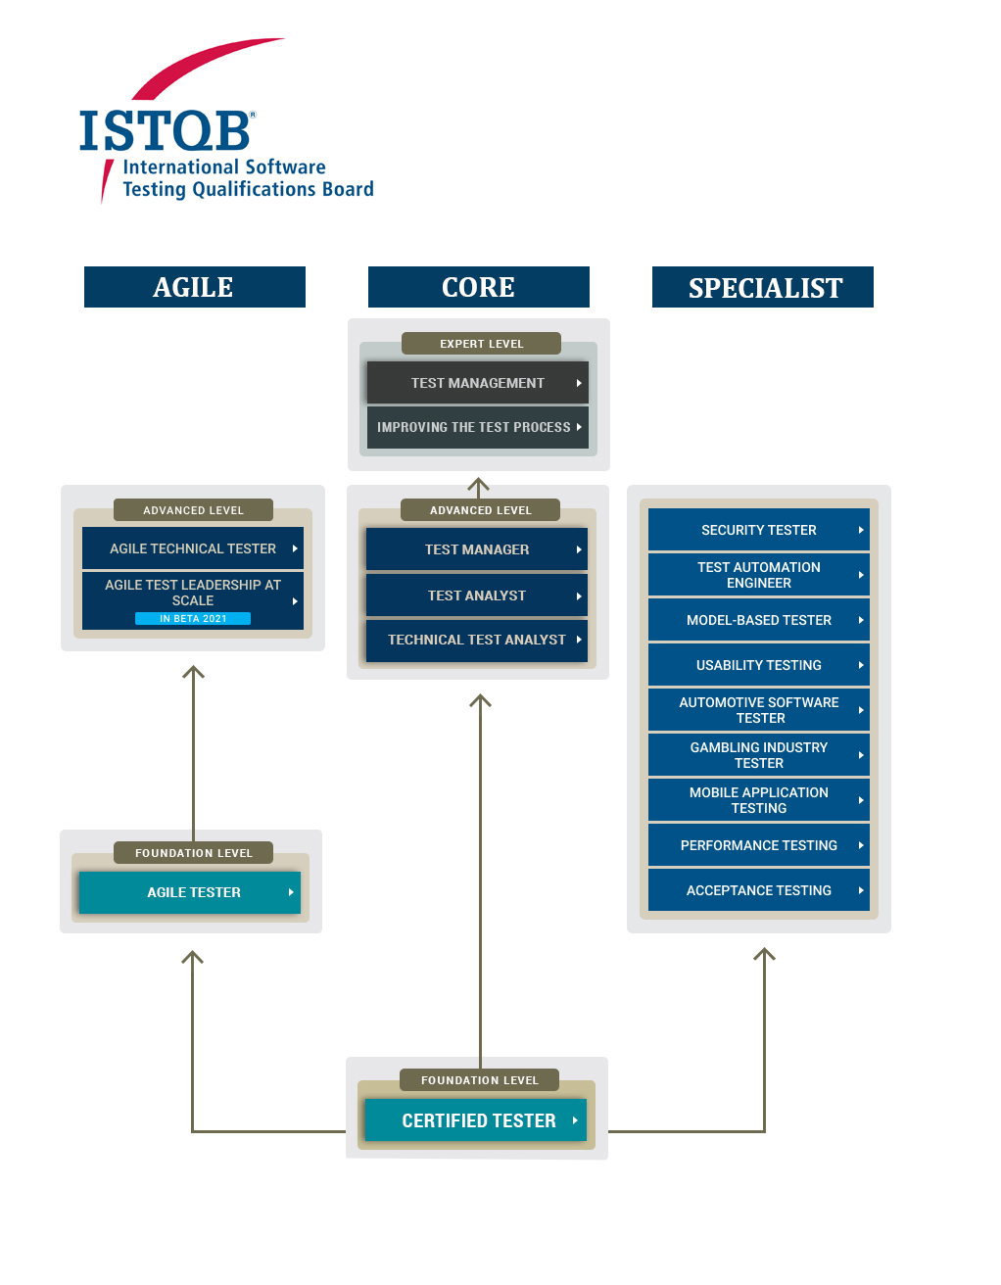
American Software Testing Qualification Board & International Software Testing Qualifications Board
https://www.istqb.org/
Why become ISTQB certified?
To improve software quality, of course.
Improved skills, recognition by others, superior chance for promotion, better job opportunities, and greater satisfaction from knowing you’ve joined an elite group of testers.
Exams: Foundation/Advance, Acceptance, Agile, Management, Security, Automation, Mobile, Usability, Performance, etc

Slide 38

Association for Software Testing
Who are we?
We are a professional non-profit association that is dedicated to building a testing community that views the role of testing as skilled, relevant, and essential to the production of software products.
We also encourage and promote the use of the principles of context-driven testing to help choose testing objectives, techniques, and deliverables for each specific testing situation recognizing that there are no best practices only good ones in each context.
We value both expertise and hands-on experience. We love the craft of testing and we take a scientific approach to developing and evaluating techniques, processes, and tools. We believe that a self-aware, self-critical attitude is essential to understanding and assessing the impact of new ideas on the practice of testing.
We are willing to question commonly held beliefs and principles about software development so as to improve the craft of software testing. For example, could it actually be cheaper to fix a bug later in the project lifecycle? Can a test be useful and valid without a predetermined result?
Publications: The AST runs CAST conferences twice a year[7]
Certificates: Black Box Software Testing (AST-BBST)

Slide 39

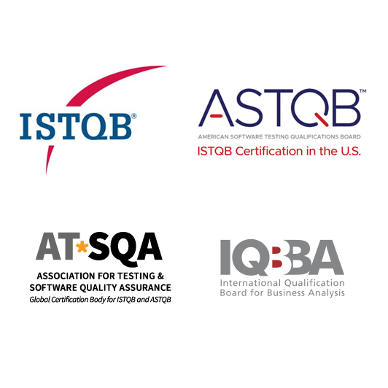
Association of Testing & Software Quality Assurance
Testing and Software Quality Assurance Professionalism
AT*SQA provides software testing certifications that support professionalism in testing and software quality assurance. We are the authoritative source for the Official U.S. List of Certified Software Testers™. Our software testing exams for ISTQB, AT*SQA, ASTQB and IQBBA are available globally online at your home, through testing centers, and onsite at your company.
We believe in the value of certification, and are proud that our quality management system has earned ISO 9001 Certification. Most of all, we are proud when we can support your skills and career development in testing and software QA!

Slide 40

DeviQA https://www.deviqa.com/
Mission: “Focus on other important aspects of your project and leave QA to our professional team.”
deviQA provides: Automated Testing, DevOps, Agile Testing, API Testing, Mobile Automation Testing, Software Testing Consultancy, Full Cycle Training, Performance Testing, Functional Testing, QA Outsourcing, Web Testing.
Community: Healthcare, Business App, Educational Software, Travel Software, Media and Entertainment, Real Estate, FinTech and Banking, Cybersecurity.

Slide 41

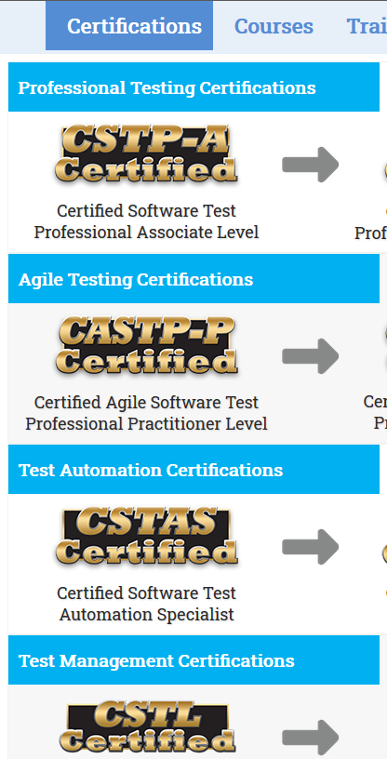
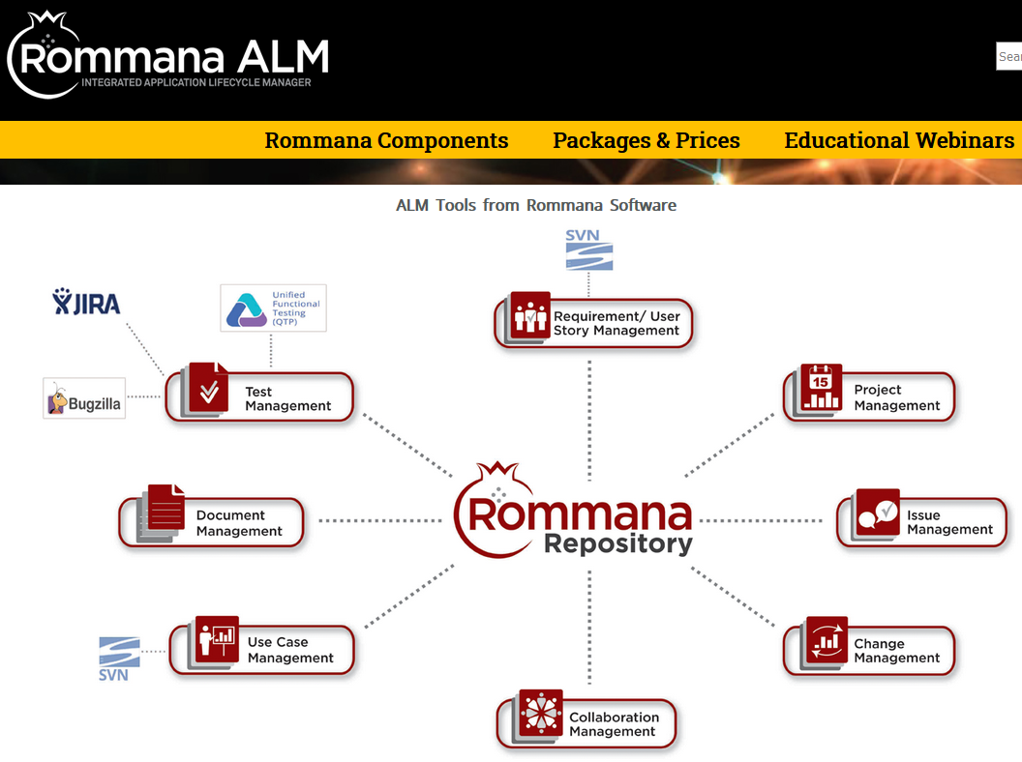
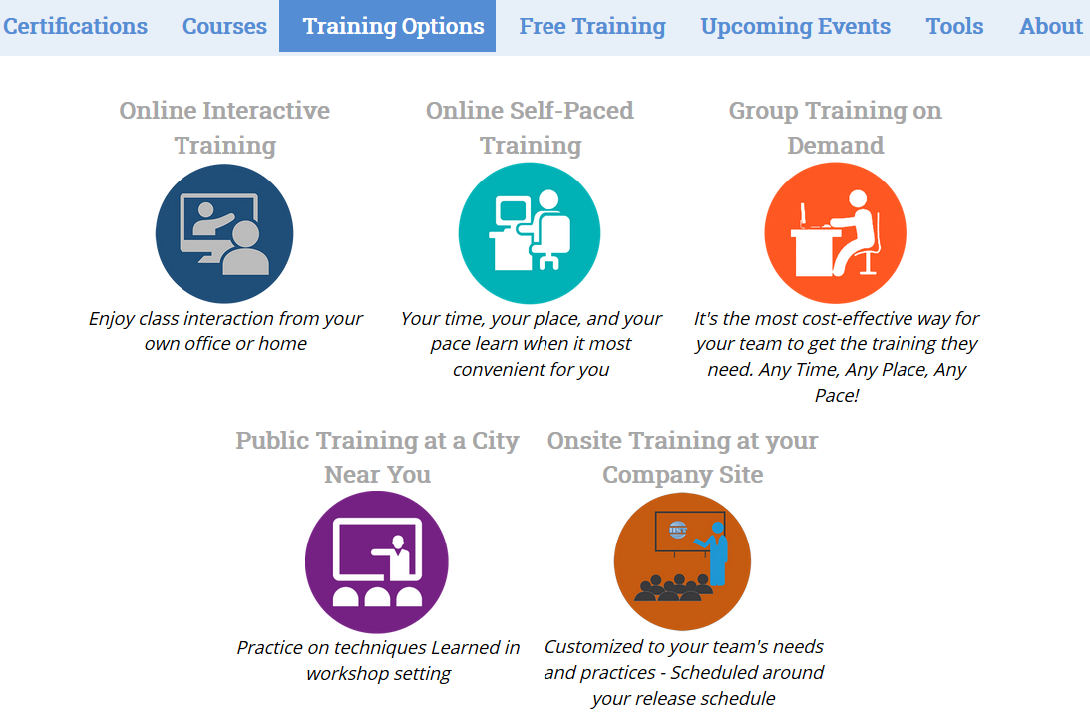
International Institute for Software Testing (IIST)
Mission
To advance the software testing profession through education-based software testing certifications
To provide free software testing training to help organizations with limited or no training budget.
The goal of their organization’s courses is not to “teach” but to share experience and provide quality training for certification.

Slide 42
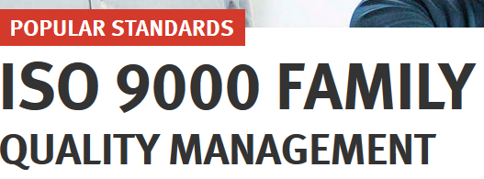
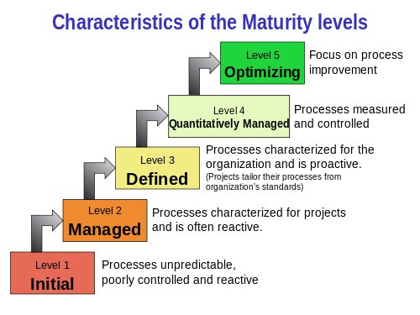
ISO
Purpose: ISO 9001 sets out the criteria for a quality management system and is the only standard in the family that can be certified to (although this is not a requirement).
An organization may decide to invite an independent certification body to verify that it is in conformity to the standard, but there is no requirement for this. Alternatively, it might invite its clients to audit the quality system for themselves.

Slide 43

ASQ
ASQ serves a membership of quality professionals through educational advancement.
ASQ certification is a formal recognition that you have demonstrated proficiency in your field. ASQ Certifications are recognized as a mark of quality excellence in many industries. – Reduce Risk

Slide 44
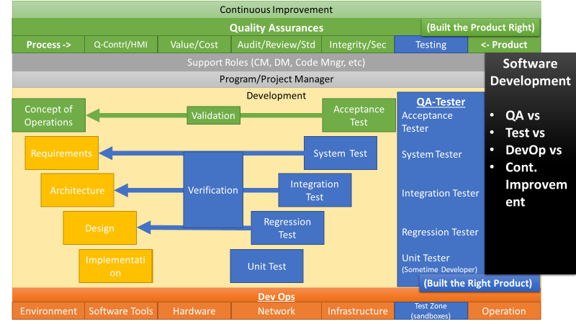
Next Week Presentations
The software has a lifecycle, much like a butterfly or moth. Each phase of the development lifecycle can use different methodologies. Each Methodology introduced more detail to each lifecycle phase.

Slide 45
Assignment of Methodologies – Roles & Poster
Concept of Operation (Concept, Objectives, Risk)
Requirements (System, Software, Architecture, Validation & Verifications)
Design (Analysis, Program Design, Prototyping, Validation & Verification)
Implementation (Coding, Building)
Testing (Unit, Sims, Integration, System, Acceptance)
Deployment (Version, Releases, DevOps)

Slide 46
Assignment of Methodologies – Roles & Plan
Teams | Assignment
Team 1
Team 2
Team 3
Team 4
Team 5
Team 6
Team 7
Team 8
Team 9
Team 10
Team 11
Team 12
Team 13
Team 14
Team 15
Concept of Operation
Concept
Objectives
Risk
Requirements
System
Software
Architecture
Validation & Verification
Design
Analysis
Program Design
Prototyping
Validation & Verification
Implementation
Coding
Building
Reviews
Testing
Unit
Sims
Integration
System
Acceptance
Deployment
Version,
Releases,
DevOps

